Slide 1

Practical 16
Write a program to verify and validate mirrored trees.

Slide 2

Lesson Plan
Subject/Course | Competitive Coding
Lesson Title | Verify and Validate if Two Binary Trees are Mirror of Each Other
Lesson Objectives
Understand the concept of mirror trees and structural symmetry in binary trees.
Learn how to compare two binary trees node-by-node recursively.
Implement an efficient algorithm to verify if two trees are mirrors of each other.
Analyze time and space complexity for recursive tree comparison.

Slide 3
Problem Statement:
Given two binary trees, determine whether they are mirror images of each other or not.
Return true if both trees are mirror images; otherwise, return false.

Slide 4
Concept
Two binary trees are said to be mirror images of each other if:
Their root nodes have the same value, and
The left subtree of one tree is a mirror of the right subtree of the other (and vice versa).
This property helps in understanding tree symmetry, which is widely used in graphics, structural analysis, and data reflection problems.

Slide 5
Algorithm/Logic
If both trees are empty → return true.
If one is empty and the other isn’t → return false.
If the root values are different → return false.
Recursively check:
Left subtree of first tree ↔ Right subtree of second tree
Right subtree of first tree ↔ Left subtree of second tree
5. Return true only if both checks are true.

Slide 6
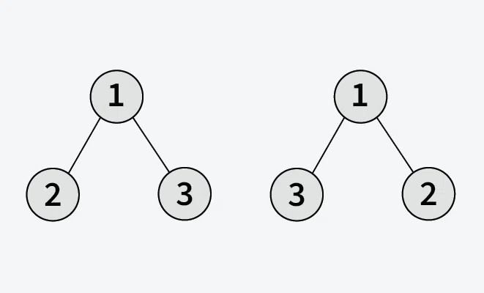
Visualization
Output: True
Explanation: Both trees are mirror images of each other, so output is True

Slide 7
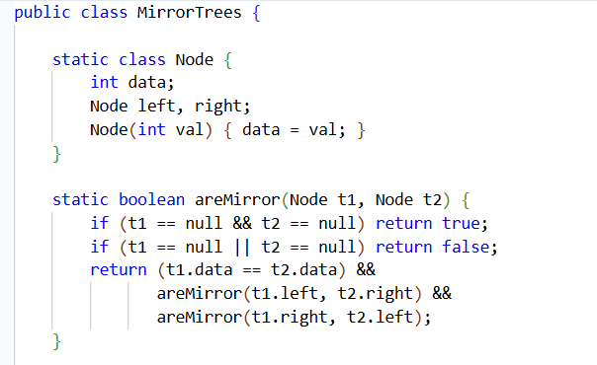
Code Implementation

Slide 8
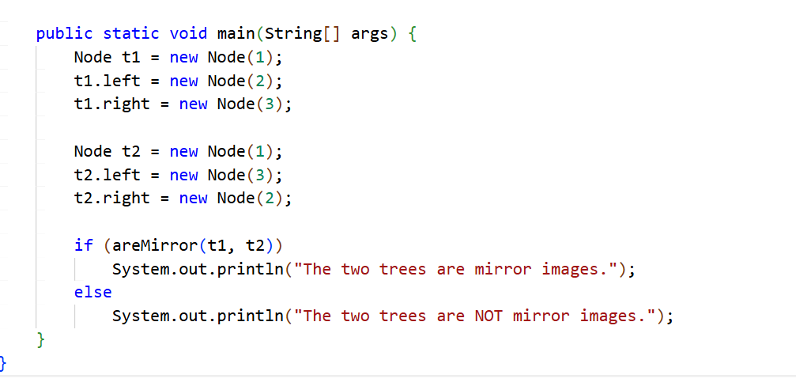
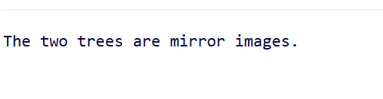
Output :

Slide 9
Time & Space Complexity
Operation | Time Complexity | Space Complexity | Explanation
Mirror Check | O(n) | O(h) | Every node is compared once; recursion depth = height of tree (h).

Slide 10
Summary
Two trees are mirrors if their structures and node values are symmetrically opposite.
Recursive comparison ensures efficient and clean checking.
Time Complexity: O(n)
Space Complexity: O(h)
Widely applied in UI rendering, data reflection, and symmetric tree validation problems

Slide 11
Practice Questions:
1. Symmetric Tree— LeetCode #101 🔗 https://leetcode.com/problems/symmetric-tree/
Concept: Check whether a binary tree is symmetric (mirror of itself) using recursive or iterative methods.
Why Practice:
Strengthens understanding of recursive tree comparison.
Builds logic for mirror structure detection and balanced tree problems.

Slide 12
Practice Questions:
2. Same Tree — LeetCode #100
🔗 https://leetcode.com/problems/same-tree/ Difficulty: Easy
Concept: Determine whether two binary trees are structurally identical and have the same node values.
Why Practice: Strengthens node-by-node comparison logic. Mirror checking is a variation of this with swapped subtree comparison.

Slide 13
Practice Questions:
3. Subtree of Another Tree — LeetCode #572
🔗 https://leetcode.com/problems/subtree-of-another-tree/ Difficulty: Easy
Concept: Check whether one binary tree exists as a subtree within another.
Why Practice: Requires structural comparison of trees. Improves understanding of recursive tree matching logic, similar to mirror verification.

Slide 14
Thanks

